Slide 1
Creating a PowerPoint Presentation

Slide 2
Learning Objectives
Planning a presentation
Create a presentation
Rearrange and delete text and slides
Add animations
Add transitions
Inserting Graphics

Slide 3
Planning a Presentation Questions to Consider
What is the purpose of the presentation?
  In other words, what action or response do you want the audience to have?
Who is the audience?
  Think about the needs and interests of the audience, as well as any decisions they will make as a result of what you have to say.
  Make sure what you choose to say to the audience is relevant to their needs, interests, and decisions, or it will be forgotten.
How much time do you have for the presentation?
  Consider the amount of time available. Make sure you pace yourself as you speak.
Will the audience benefit from printed output?
  Some presentations are effectively delivered with onscreen visuals.
  Others require printed support materials because there is too much information to be displayed on the screen.
  In other cases, you want the audience to have something to take with them to help remember what you said.

Slide 4
Creating a Presentation
PowerPoint is a powerful presentation graphics program used to create slides that can contain
  text
  charts
  pictures
  sound
  movies
Files created in PowerPoint are called presentations, which consist of slides.
You can show these presentations as
  slide shows on a computer monitor
  project them onto a screen
  share them over the Internet
  publish them to a Web site.
You can also create documents from the presentation by printing the slides, outlines, or speakers’ notes.

Slide 5
Creating a Presentation
Topics Covered:
  Creating a Title Slide
  Adding a New Slide and Choosing a Layout
  Moving Between Slides in Normal View
  Working with Bulleted Lists
  Using AutoFit
  Changing Themes
  Modifying Text and Changing Bullet Levels in the Outline Tab

Slide 6
Creating a Presentation
When PowerPoint opens, it displays a blank presentation in Normal View.
Normal view The PowerPoint view that displays
  Slides one at a time in the Slide pane
  Thumbnails of all the slides in the Slides tab
  All the text of the presentation in the Outline tab.

Slide 7
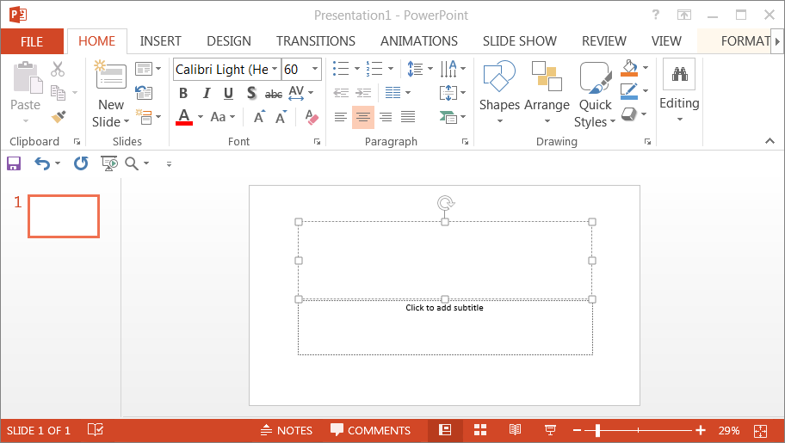
Creating a Presentation
Slide pane - The area of the PowerPoint window that displays the currently selected slide as it will look during the slide show.
The area of the PowerPoint window that shows a column of numbered slide thumbnails so you can see a visual representation of several slides at once.

Slide 8
Creating a Title Slide
The first slide in a PowerPoint presentation is usually the title slide, which typically contains the title of the presentation and a subtitle, often the presenter’s name.
Placeholder - A region of a slide reserved for inserting text or graphics.
Text placeholder - A placeholder designed to contain text.

Slide 9
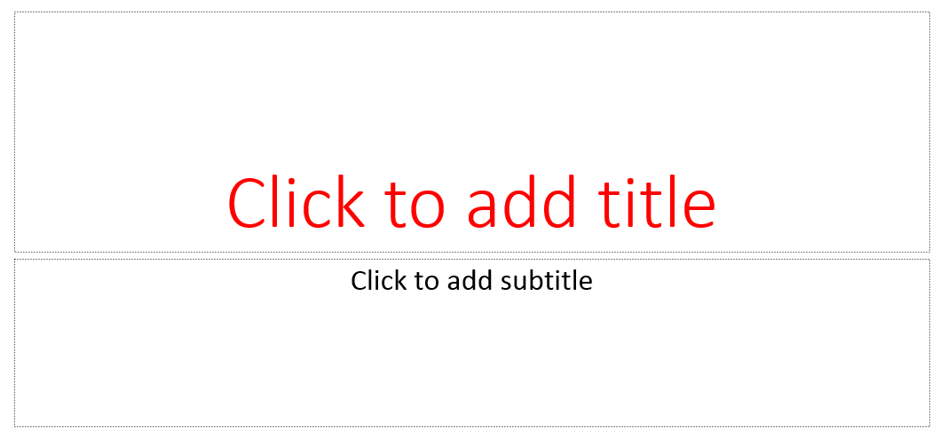
Creating a Title Slide
Title text placeholder - A placeholder designed to contain the presentation title or slide title..
After you enter text into a text place-holder, it becomes a text box, which is simply a container that holds text.
Subtitle text placeholder - A placeholder designed to contain the presentation subtitle.

Slide 10
Adding a New Slide and Choosing a Layout
After the title slide, you need to add additional slides to the presentation.
When you add a new slide, the slide is formatted in a layout.
A layout is a predetermined way of organizing the objects on a slide.

Slide 11
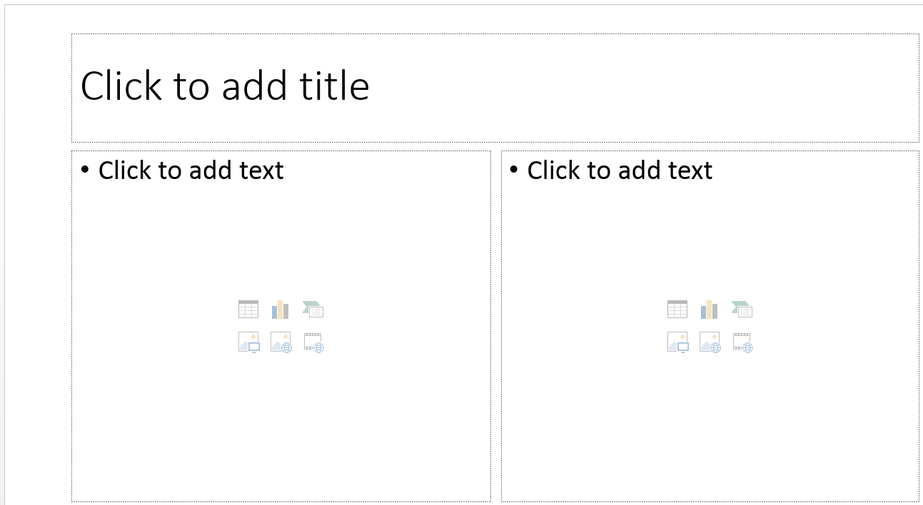
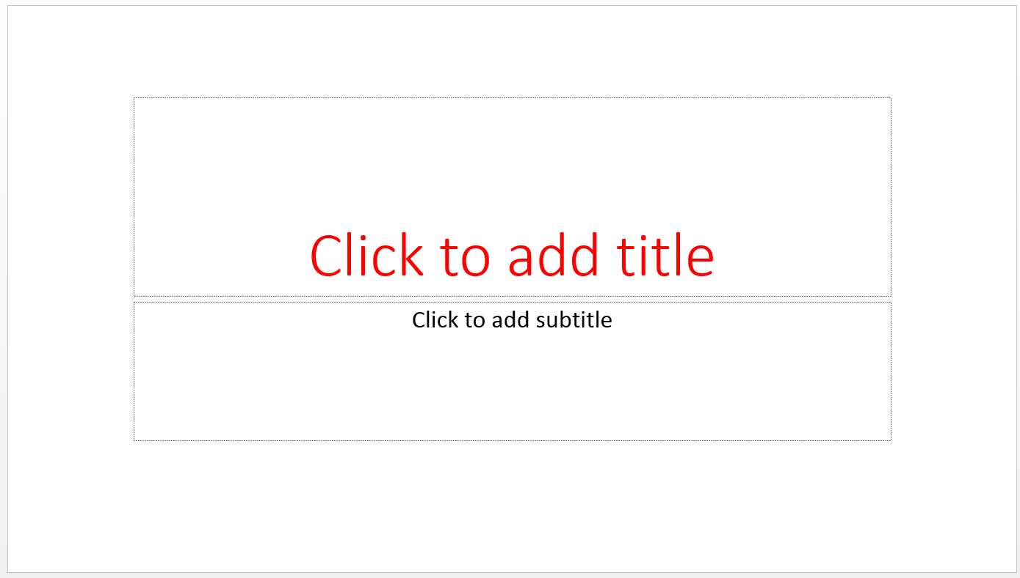
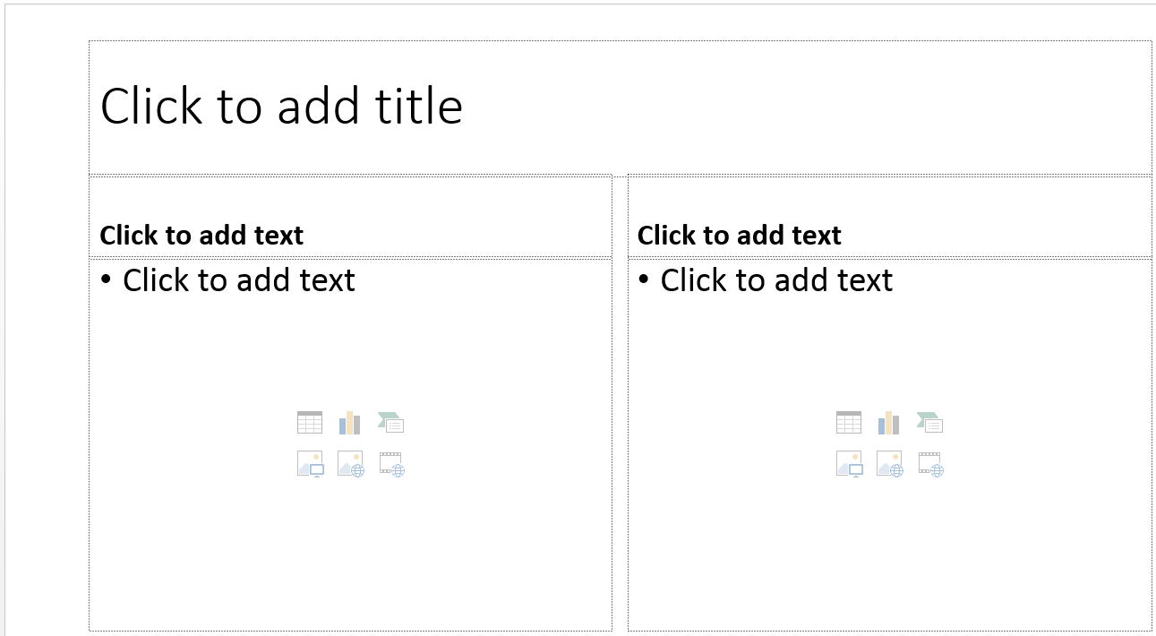
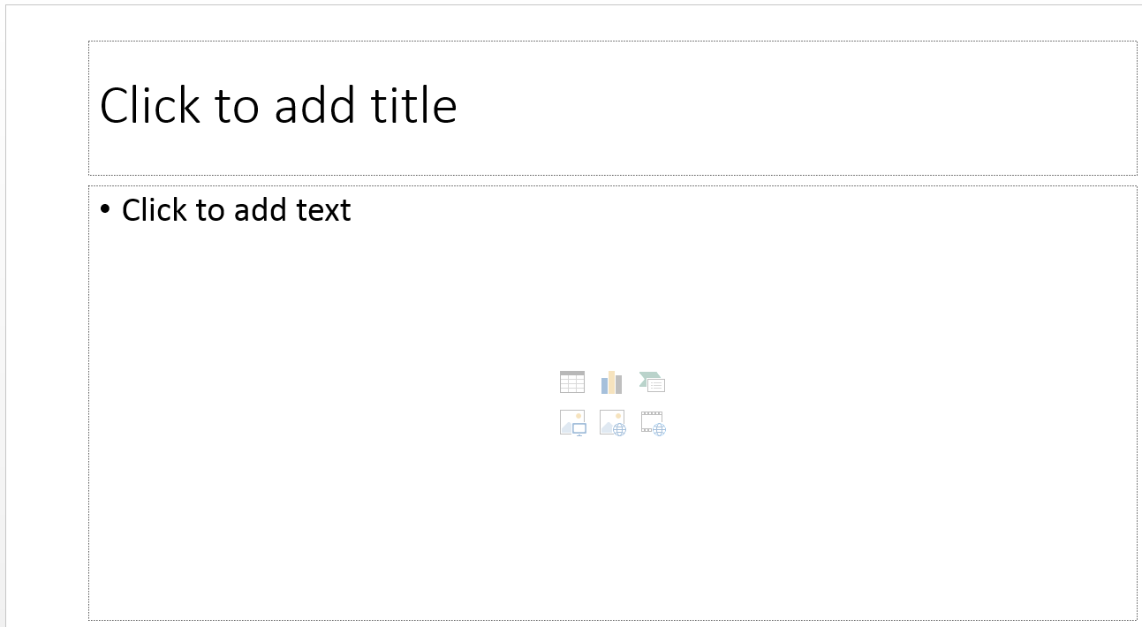
Build-in Layouts in PowerPoint
Title Slide - Contains the presentation title and a subtitle
Title and Content - Contains either a bulleted list or a graphic in addition to the slide title
Two Content - The same as the Title and Content layout, but with two side-by-side content placeholders, each of which can contain a bulleted list or a graphic
Comparison - The same as the Two Content layout, but includes text placeholders above the content placeholders to label the content

Slide 12
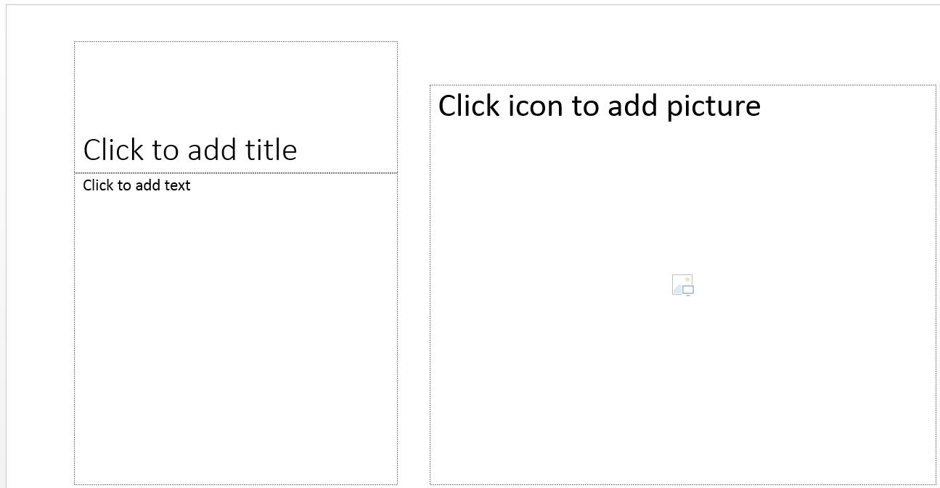
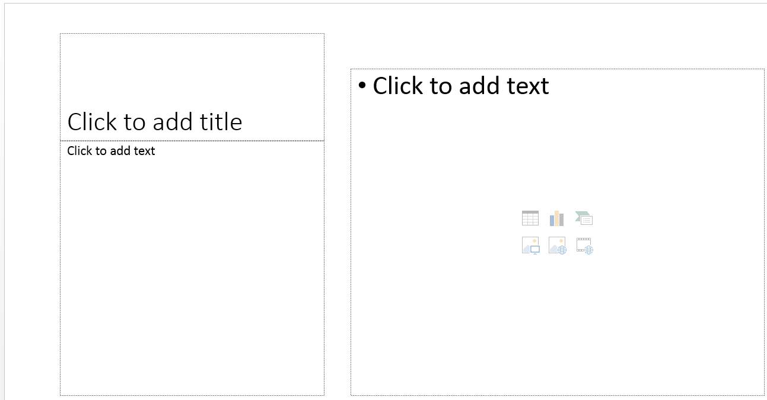
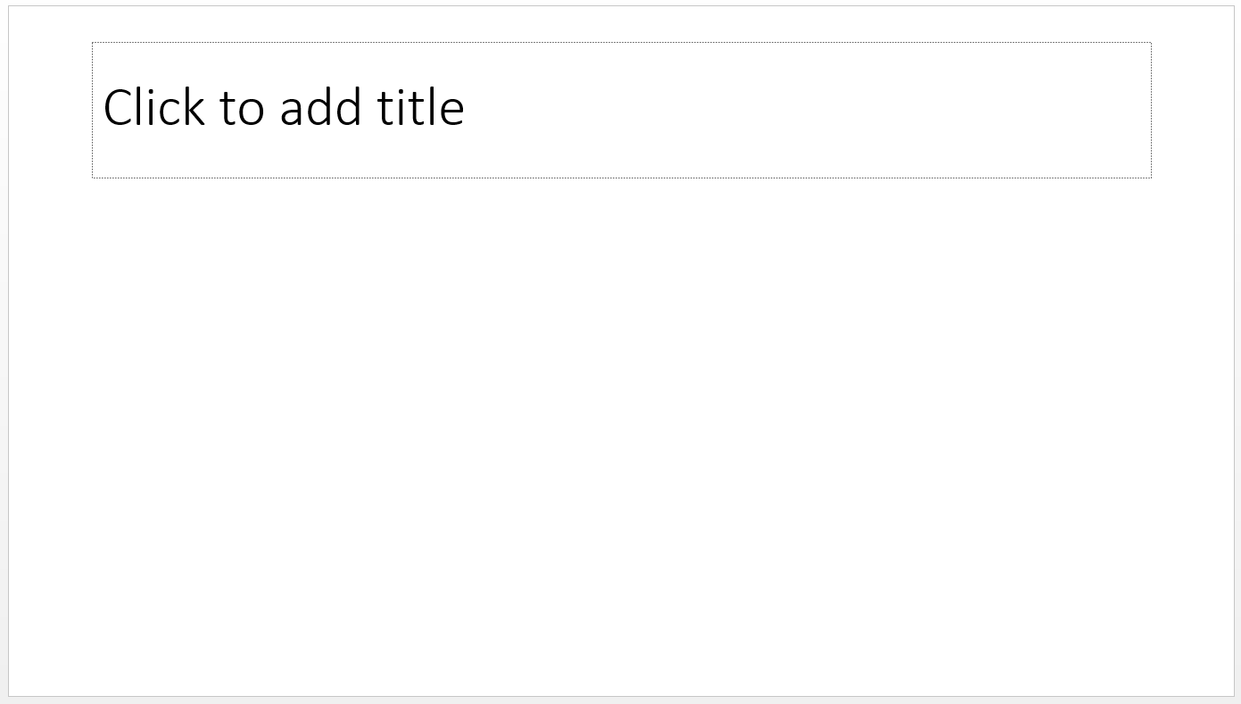
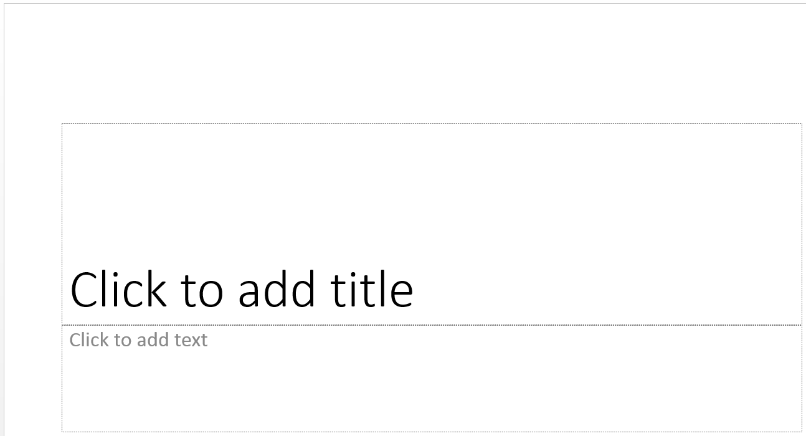

Build-in Layouts in PowerPoint
Title Only - Includes only a title text placeholder for the slide title
Section Header - Contains a section title and text that describes the presentation section
Content with Caption - Contains a content placeholder, a title text placeholder to identify the slide or the content, and a text place-holder to describe the content; suitable for photographs or other graphics that need an explanation
Picture with Caption - Similar to the Content with Caption layout, but with a picture placeholder instead of a content placeholder
Blank - Does not contain any placeholders

Slide 13
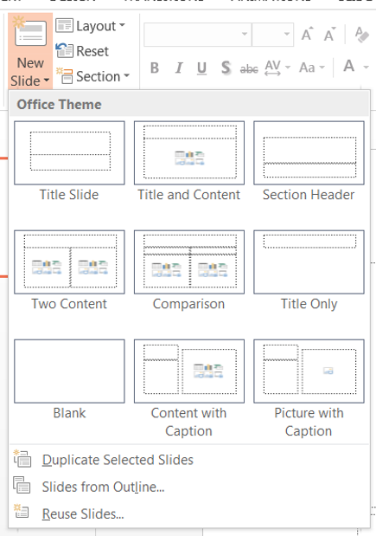
Adding a New Slide and Choosing a Layout
New slide layouts are found on the home tab
The New slide dropdown arrow will show all of the slide layouts.
The New Slide button will add the last used slide to the presentation.

Slide 14
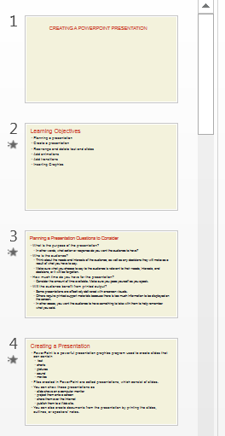
Moving Between Slides
The pane on the left shows you thumbnails of the slides in your presentation. You can click a slide thumbnail in the Slides tab to display that slide in the Slide pane.
You can also use the scroll bar in the Slide pane to scroll from slide to slide

Slide 15
Working with Bulleted Lists
Often, text on a slide is in the form of bulleted lists to emphasize important points to the audience.
Bulleted list - A list of paragraphs with a special symbol to the left of each paragraph.
Bulleted lists include:
  Bulleted items - One paragraph in a bulleted list.
  Subbullet - A sub paragraph in a bulleted list, positioned below and indented from a higher- level bullet.
To add a bulleted list to a slide, click in a content place- holder and start typing.
To add a subbullet, press Tab.
To create a new line with no bullet, press the Shift+Enter
keys.

Slide 16
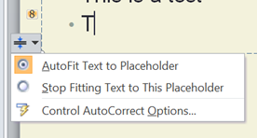
Using AutoFit
As you add text to a content placeholder, the AutoFit feature changes the line spacing and the font size of the text
If you add more text than will fit in the placeholder the AutoFit feature is turned on by default.

Slide 17
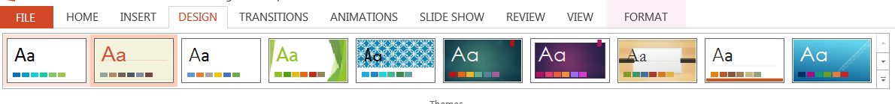
Changing Themes
A theme changes the fonts and color used for the background, title text, body text, accents, and graphics in a presentation as well as the style used in your presentation.
The theme you choose for a presentation should reflect the content and the intended audience.
Themes are found on the Design Tab

Slide 18
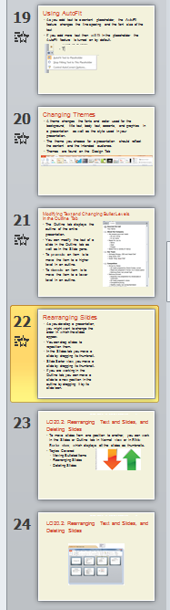
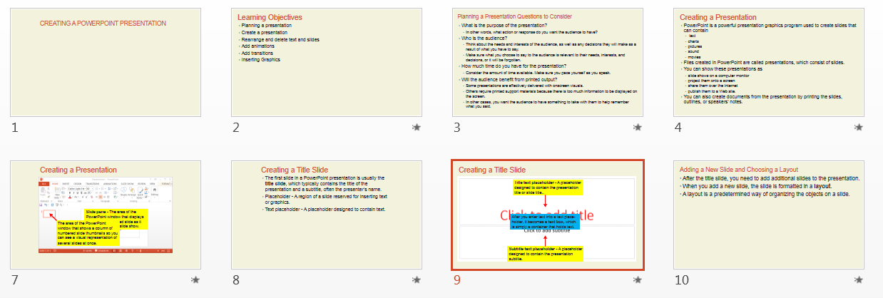
Rearranging Slides
As you develop a presentation, you might want to change the order in which the slides appear.
You can drag slides to reposition them.
In the Slides tab you move a slide by dragging its thumbnail.
Slide Sorter view, you move a slide by dragging its thumbnail.

Slide 19
Deleting Slides
You can delete slides in the Slides and Outline tabs in Normal view and in Slide Sorter view.
To delete a slide, right-click the thumbnail in the Slides tab or Slide Sorter view, and then click Delete Slide on the shortcut menu.
You can also click its thumbnail in the Slides tab or Slide Sorter view or click the slide icon in the Outline tab, and then press the Delete key.

Slide 20
Adding Animations
Animations are special effects applied to an object, such as a graphic or a bulleted list, that make the object move or change.
Animations add interest to a slide show and draw attention to the text or object being animated.
When you choose an animation, keep the purpose of the presentation and the audience in mind.
Although you want to capture the audience’s attention, you should not select an animation that appears frivolous, such as one that makes the text bounce or spin onto the screen.

Slide 21
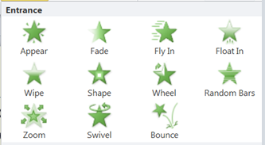
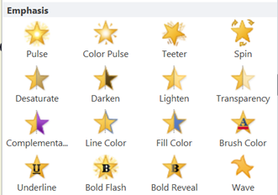
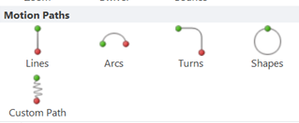
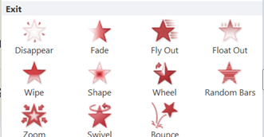
Adding Animations
Animation effects are grouped into four types:
  Entrance - Text and objects animate as they appear on the slide; one of the most commonly used animation types.
  Emphasis - The appearance of text and objects already visible on the slide changes or the text or objects move in place.
  Exit - Text and objects leave the screen before the slide show advances to the next slide.
  Motion Paths - Text and objects move following a path on a slide.

Slide 22
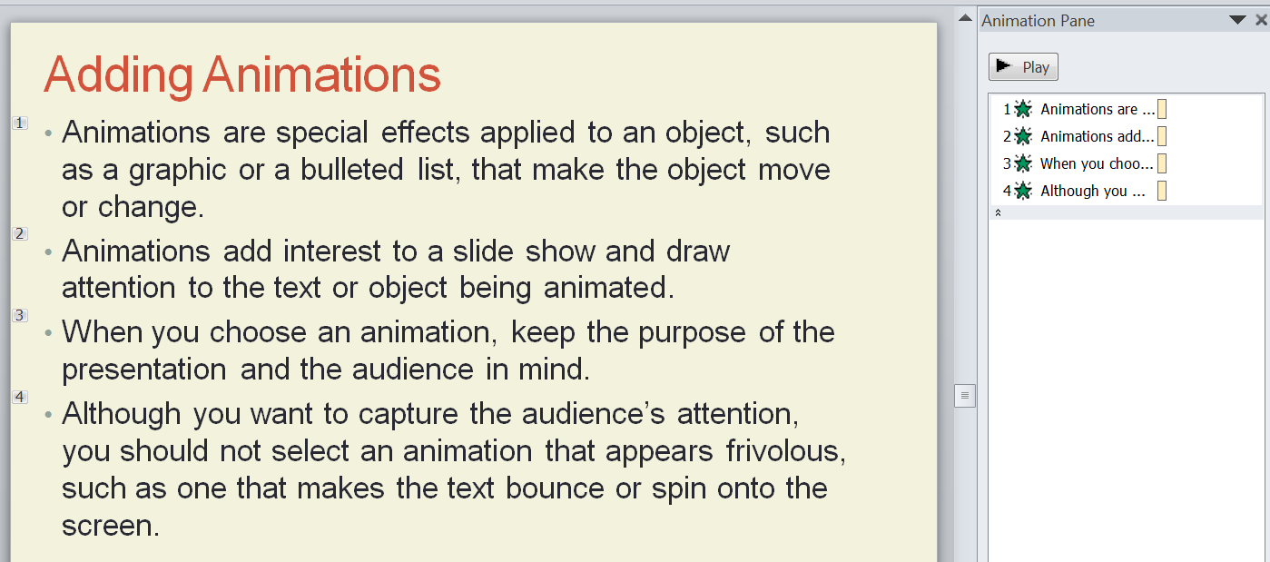
The Animation Pane
The Animation Pane is where you can see all of the animations that are on a slide.
The Animation Pane button is found the Animations tab.
You can do the following in the Animations Pane.
See the order of objects (in this case bullets) on the slide.
If objects on a slide do not animate in the order you expected, you can change the order of the animations
Remove object animations by selecting the individual animations and pressing the delete key.

Slide 23
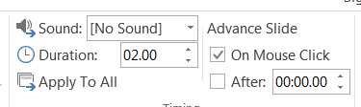
Slide Transitions
When you move from one slide to another in PowerPoint, the next slide simply appears on the screen in place of the previous slide.
To make the slide show more interesting, you can add transitions between slides.
A transition is a special effect that changes the way a slide appears on the screen in Slide Show or Reading view.
Slide transitions are found on the Transitions tab.

Slide 24
Selecting Appropriate Font Colors
When you select font colors for use on slides or when you modify the slide background, make sure your text is easy to read on the slide during a slide show.
Font colors that work well are dark colors on a light background, or light colors on a dark background.
Avoid red text on a blue back-ground or blue text on a green background ( and vice versa) unless the shades of those colors are in strong contrast.
Also avoid using red/ green combinations, which color- blind people find illegible.

Slide 25
Selecting Appropriate Font Colors
Good Color Combination
Poor Color Combination
Good Color Combination
Poor Color Combination

Slide 26
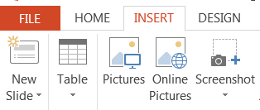
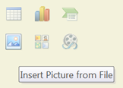
Inserting a Picture from a File
You can insert graphics stored on your computer on a slide using the
  Insert Picture from File button in a content placeholder
  The Picture button in the Images group on the Insert tab.

Slide 27
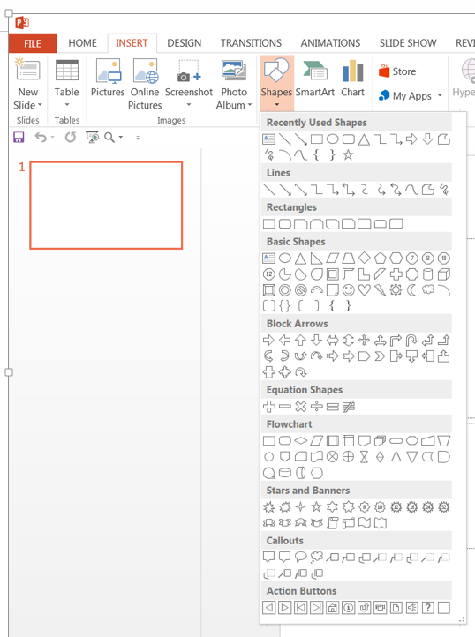
Drawing a Shape
Another way to add a graphic to add a basic shape to the slide.
To add text to a shape go to the insert menu and click on the Shapes button.
This opens a selection of shapes that can be added to the slide.
Select the shape you want to use and draw it on the slide.

Slide 28
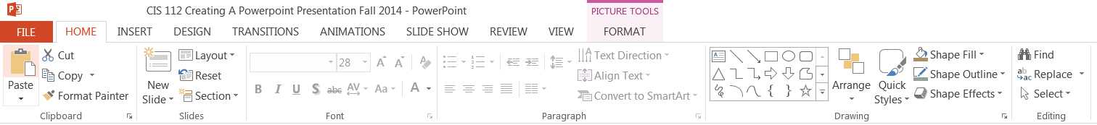
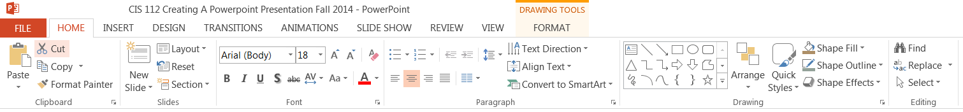
Formatting Graphics
You can apply formatting to any object on a slide.
You do this by clicking on the object.
This will open the formatting options for the type of object you have selected.
Two examples are;
  Picture Tools
  Drawing Tools

